Slide 1
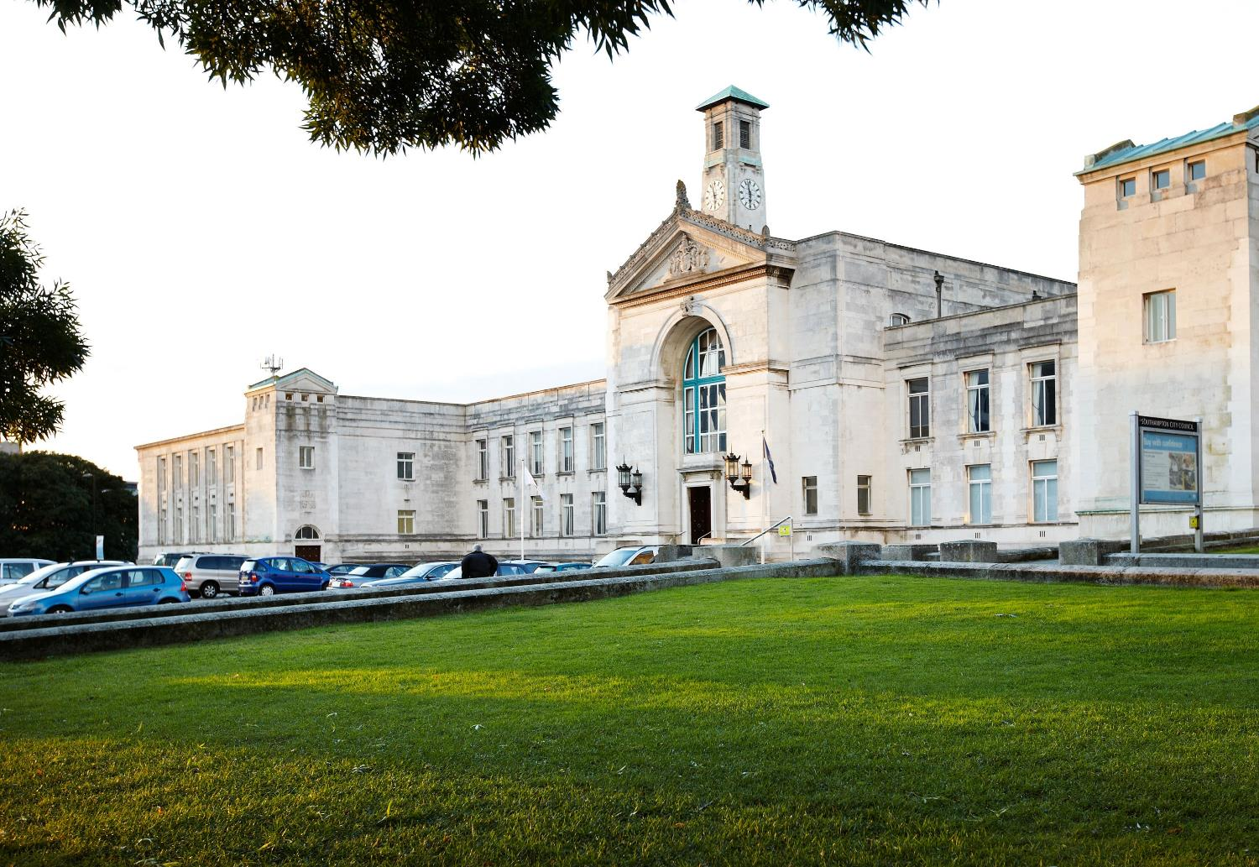
Private Housing enforcement in Southampton
Steven Hayes-Arter – Service Manager

Slide 2
Private Housing enforcement in Southampton
Enforcement of the sector in the City – issues, demand, our approach
HMO licensing in Southampton – Mandatory & additional – effectiveness of schemes on sector
Present & future challenges – new legislation & regulation

Slide 3
Southamptons private sector
Private rented sector accounts for approx. 28,000 properties
Spread throughout all wards across the city.
Mixed tenure and property types. From bedsits to large HMOs.
Huge variation in age and quality of stock, from pre-war terrace to modern purpose-built blocks & houses
Variable standards in terms of repair and upkeep
Provides an integral part of the housing market ensuring there is accommodation for the needs of the population.

Slide 4
Enforcing the City's private sector
Reactive inspection of properties using Housing Act 2004 part 1 powers (HHSRS)
These are only where tenants have made complaints or raised issues
This includes HMOs (not covered by licensing) & all other private rented accommodation (excluding social housing)
Proactive programme of inspection and enforcement of high-rise fire safety risks (cladding) in partnership with Fire authority
SCC has received some funding from DLUHC for this programme of work
Mandatory HMO licensing
Additional HMO licensing. No current scheme but part of future plans

Slide 5
Enforcing the City’s private sector
All work carried out across two teams – Private Sector Housing & HMO licensing.
PSH team consists of 3.5FTE & currently 2FTE EHO apprentices largely providing support for the High-Rise fire safety programme. All staff are funded from the Capital fund.
HMO licensing team of 6.5FTE funded by licence fees.
10 FTE covering enforcement of sector of approximately 28,000 properties.
Demand for services & lack of resources means that all PSH service requests are triaged.

Slide 6
Enforcing the City’s private sector
Service demand – consistent year on year

Slide 7
Enforcing the City’s private sector
Inspections of properties
Pandemic had significant impact from 2020 to 2022.
All service requests are triaged, and inspection is only carried out where likelihood of significant hazard (Cat 1, HHSRS) is identified.
Numbers indicate less than 20% of complaints lead to inspection.
Housing cases are often lengthy & prolonged due to legislative rules.
Officers will have to visit property multiple times to serve notices and check compliance
 | 2019/20 | 2020/21 | 2021/22 | 2022/23 | 2023/24 | Total
HHSRS inspections | 48 | 24 | 42 | 88 | 63 (so far) | 265

Slide 8
Enforcing the City’s private sector
Main issues affecting the private stock
Damp & Mould – significant increase over last two winters
Excess cold – lack of effective fixed heating or broken and poorly performing appliances. Lack of insulation.
Electrical safety
Vermin
 | 2019/20 | 2020/21 | 2021/22 | 2022/23 | 2023/24
Damp & mould | 71 | 47 | 48 | 103 | 116
Broken heating & electrics | 36 | 32 | 27 | 30 | 52
Rats or bedbugs | 12 | 29 | 15 | 25 | 25

Slide 9
Enforcing the City’s private sector
Where significant hazards (Cat 1 HHSRS) are identified the LA is required to take enforcement action.
Various enforcement notices available under Housing Act 2004
Most commonly used are Improvement & prohibition notices
Failure to comply with notices is an offence and can lead to prosecution and or service of Civil Penalty Notices.
Approach published in Private Sector Housing Enforcement Policy, including Civil Penalty Policy.
Civil penalties are a relatively new power and SCC is yet to issue one. This will change going forward.
Income from Civil Penalties can be used to support Private housing enforcement.

Slide 10
Enforcing the City’s private sector
Enforcement notices served by PSH team
Notices are generally issued after required work is not completed
Landlord is charged for notice
Failure to comply is an offence and can lead to prosecution
Fortunately, compliance rates are very high and prosecution levels are very low currently. Two in past five years.

Slide 11
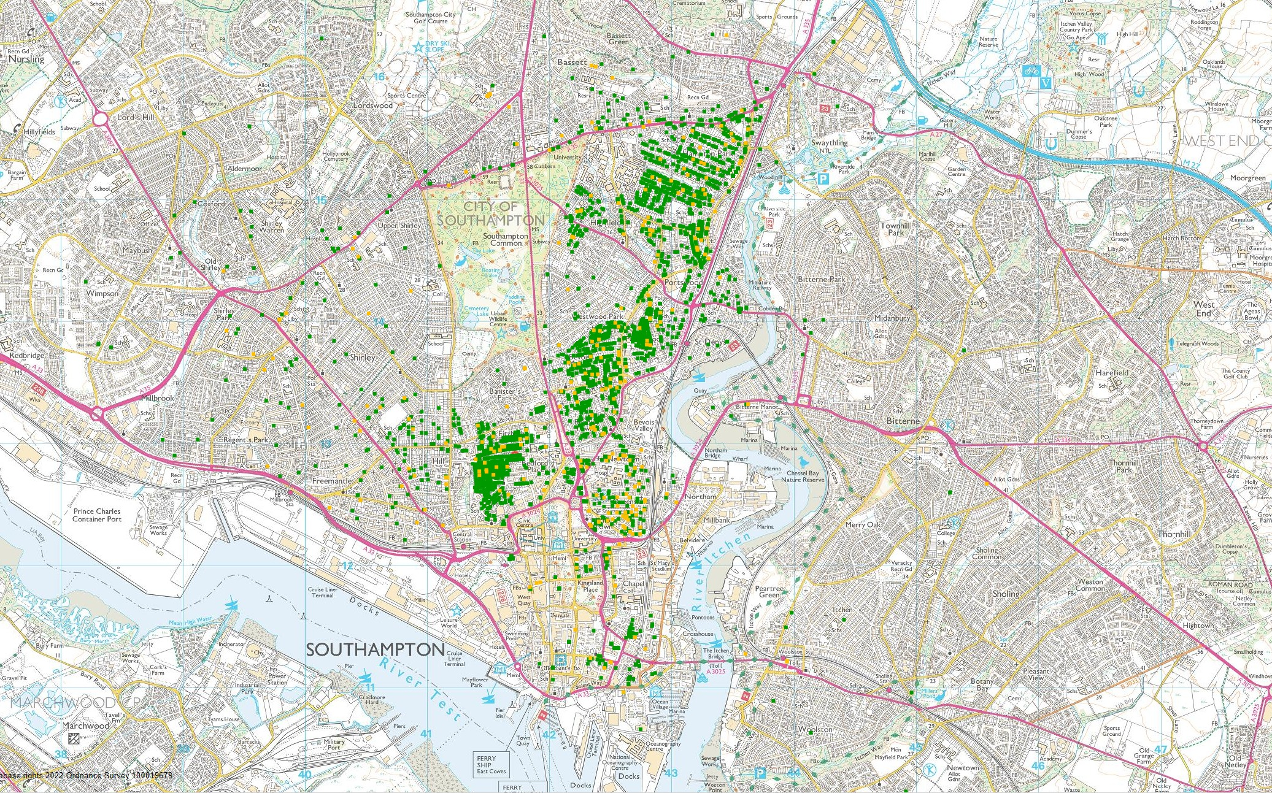
Mandatory HMO licensing
There are approximately 6000-7000 HMOs in Southampton.
In the city we have between 2300- 2500 Mandatory HMOs, which require licensing every five years.
The majority of the HMOs are situated within the central wards of the city, predominantly in Bevois, Bargate & Portswood.

Slide 12
Mandatory HMO licensing
Legal requirement for LAs to license larger HMOs in their area
This covers all HMOs with 5 or more residents from 2 or more households. There are some exemptions such as those owned or managed by Educational establishments.
Regulations impose certain mandatory conditions that HMOs and licence holders must meet.
These include standards for minimum rooms sizes (sleeping accommodation), fire safety & provision of gas safety certificate
Housing Act 2004 (legislation.gov.uk)
https://www.legislation.gov.uk/uksi/2018/221/made
In addition LAs can set local licence conditions in relation to management, use and occupation of the HMO

Slide 13
Mandatory HMO licensing
Southampton CC has its own published HMO standards that cover all HMOs in the city, including those not requiring licensing.
See Guidance on standards for Houses in Multiple Occupation (HMOs) (southampton.gov.uk)
This sets out the requirements for room sizes, amenities, fire safety, conditions & management.
Requirements will vary depending on HMO type, e.g. shared tenancy, bed sit type etc.
SCC uses the Mandatory minimum room sizes for all HMOs.
Fire safety requirements based on LACORS guidance guidance-on-fire-safety-provisions-for-certain-types-of-existing-housing.pdf (cieh.org) and Fire risk assessment (which landlords must carry out)

Slide 14
Mandatory HMO licensing
Breakdown of Mandatory HMOs by ward
Wards not listed have <30 HMOs
Ward | No of licensed Mandatory HMOs
Bevois | 600
Portswood | 540
Bargate | 430
Swaythling | 300
Freemantle | 170
Bassett | 100
Banister & Polygon | 72
Shirley | 49

Slide 15
Mandatory HMO licensing
Every HMO is inspected prior to licence being issued.
Either by SCC HMO surveyor or Accredited independent surveyor (CIEH or RICS certified)
Landlord has option if application is within 3 months of property becoming licensable or renewal date.
Landlord pays reduced fee if using independent surveyor.
Independent surveyor issues ‘certificate of compliance’ to verify HMO meets SCC standards, in order to obtain full licence.
SCC carries out auditing of percentage of these properties to ensure standards are met

Slide 16
Mandatory HMO licensing
SCC HMO surveyor may issue the HMO licences with specific conditions attached. E.g. improve fire detection within specified time period.
These conditions are then checked to ensure compliance.
This conditions monitoring is a vital part of the licensing programme.
Failure to comply with any condition is a breach of the licence and can result in enforcement action & ultimately the revocation of the licence.
Could result in issue of Civil Penalty Notice and or prosecution.
Successful prosecutions can lead to banning orders.
15 HMO landlords have been prosecuted since 2014
Compliance now very high

Slide 17
Mandatory HMO licensing
HMO licensing is an effective tool in managing the condition and impact of HMOs
In Southampton, licensing of HMOs has led to a 75% reduction in complaints from tenants relating to their conditions.
50% reduction in complaints about HMOs from neighbours and residents. Particularly in regards noise nuisance, waste and anti-social behaviour.
This has been achieved through Mandatory & Additional HMO licensing over the past 10 years

Slide 18
Additional HMO Licensing
Southampton City Council has also operated three additional HMO licensing in certain wards within the city over the past ten years.
Additional licensing schemes (under part 2 of the Housing Act 2004) allow LAs to licence smaller HMOs, and ‘cluster flats within purpose-built student blocks.
Any HMO with 3 or more persons forming 2 or more households. Essentially any HMO not captured by the Mandatory scheme
Schemes have covered the four central wards of Bevois, Bargate, Portswood & Swaythling and also the western wards of Shirley, Freemantle, Bassett & Millbrook.
The most recent scheme covering the central wards ended on September 30th.

Slide 19
Additional HMO Licensing
Additional schemes can only run for five years & run on a ‘cost recovery’ basis.
Schemes cannot be ‘renewed’. An Additional HMO licensing scheme is designated under delegated powers & requires public consultation & Cabinet approval.
Scheme must meet with prescribed conditions set out in the Housing Act 2004 part 2. e.g. must meet the legal threshold. Housing Act 2004 (legislation.gov.uk)
Schemes can be subject to Secretary of State approval & withdrawn if legal threshold is not sufficiently met.

Slide 20
Additional HMO licensing
Designation of Additional HMO licensing scheme dependant on meeting legal test. Most notably;
A Local Authority must consider that a significant proportion of the HMOs in the area are being managed sufficiently ineffectively as to give rise, or to be likely to give rise, to one or more particular problems either for those occupying the HMOs or for members of the public.
An LA must have also considered whether there were any other courses of action available to them, that might provide an effective method of dealing with the problem or problems in question, and
that making the designation will significantly assist them to deal with the problem or problems (whether or not they take any other course of action as well).

Slide 21
Additional HMO Licensing
First designation made in 2013. Majority of evidence used for justification came from 2008/9 Stock Condition & HMO survey of City.
Estimated approx. 4000 HMOs would be licensed.
Scheme saw approx. 3600 licensed
At end of 5 years, compliance rate with conditions at 62%
Successful but still work to do.
Second designation in western wards (Shirley, Freemantle, Millbrook & Bassett) introduced in 2015.
Estimated approx. 1500 HMOs, but only 600 licensed by end of scheme in 2020.
Compliance very high at 80%.

Slide 22
Additional HMO Licensing
Third designation introduced in Autumn 2018 covering same central four wards as first scheme (2013).
Justification for further scheme due to compliance rate (62%) indicating that management of some HMOs was still not sufficient.
Scheme was smaller than first designation, reducing from approx. 3600 to 2200 HMOs due to changes in Mandatory licensing in 2018.
Scheme was as previously well supported and overall compliance very high, ending at approx. 90%. So a significant improvement from 2018.
Success of scheme however makes further designations less easy to justify.
In order to satisfy the legal tests, robust case needed that licensing is the most effective tool to ensure sufficient management of HMOs

Slide 23
Additional HMO licensing – past & future
2013-2018 - first Additional HMO licensing designation, covering Bargate, Bevois, Portswood & Swaythling – approx. 3600 HMOs
2015-2019 – second additional HMO licensing designation , covering Freemantle, Shirley, Millbrook & Bassett – approx. 600 HMOs
2018-2023 – Third designation, covering same four wards as designation one (Bevois, Bargate, Portswood & Swaythling) – approx. 2,200 HMOs
2024-2029 – Current proposals looking at an Additional HMO licensing designation covering, Bargate, Banister & Polygon, Bevois, Freemantle, Shirley, Portswood, Swaythling & Bassett. This incorporates all areas previously covered by past schemes – would capture approx. 2,800-3000 HMOs

Slide 24
Additional HMO Licensing – future plans
Previous additional licensing has captured approx. 2800 HMOs across the city. (Mostly within central spine)
In conjunction with Mandatory it has resulted in approx. 5000 HMOs of the estimated 6-7000 in the city being covered by licensing.
Very effective tool to ensure HMO stock is safe and well managed
Now looking at proposing a further additional designation in 2024 to capture the majority of the City’s HMOs & keep standards high.

Slide 25
Additional HMO Licensing – future plans
Data from past schemes shows us where the HMOs are located (wards)
98% of the City’s known HMOs could be licensed by designating a new scheme covering 8 wards;
Banister & Polygon
Bevois
Bargate
Swaythling
Portswood
Bassett
Shirley
Freemantle

Slide 26
Additional HMO Licensing – future plans
Designation would capture between 2800-3000 HMOs including all of the Purpose-Built Student accommodation blocks.
Ideally SCC would have new data sets for the city from a more recent stock condition survey to support the case for a new designation.
So far this has not been commissioned due to costs far exceeding budget. (Cost circa £500k, budget £125K)
Report can however go forward for Cabinet approval and public consultation using HMO data from past ten years of licensing.
Risk of challenge, but support has been strong previously from crucial partners and supporters.
Hopefully benefits of new scheme are clear and would be supported by the Scrutiny committee?

Slide 27
Selective licensing
The committee has heard case studies from other LAs on the use of Selective licensing.
Can be used separately or in parallel with Additional HMO licensing
Requires legal tests to be met, similar but not the same as additional HMO licensing.
More challenging to gather evidence, lots of data required, ideally stock condition survey needed beforehand.
Has potential to target parts of sector that are otherwise hard to reach or engage with, smaller non-HMO market.
Can be used to raise income for private sector housing enforcement work and lead to increased enforcement activity
Resource intensive & costly to set up, but options to ‘outsource’.

Slide 28
Selective licensing
Circa 20,000 Private rented properties not covered by HMO licensing schemes.
No landlord registration required so sector can slip under the radar.
Selective licensing can target some or all of these, depending on ambition of LA.
Larger schemes capturing more than 20% of sector require SoS approval but small schemes do not.
Many LAs start small e.g. targeting a small number of certain wards
In Southampton the wards most likely to meet criteria would be the central areas.
This could mean certain wards require all PSH & HMOs to be licensed.
Selective licensing could be a useful tool to tackle the sector in our city

Slide 29
Future plans & challenges
Additional HMO licensing has been very successful in Southampton & further designations should hopefully continue to ensure that the HMO sector is well managed and provides safe accommodation.
The schemes pay for themselves (cost recovery) and we already have a well established team in place & through additional scheme income, ability to increase resources.
Selective licensing has the potential to help regulate other parts of the private rented sector
A small scheme should be justifiable and would allow us to gauge its effectiveness as a tool in our City.
However consideration is needed on whether this is out-sourced or completed in-house. There are of course significant financial implications in the introduction of selective licensing.

Slide 30
Future plans & challenges
Current and future work programme around high-rise fire safety (cladding) is putting pressure on already stretched resources.
Work needs to continue through 2024/25 to address issues on several blocks within the city.
New guidance on damp and mould and changes to HHSRS – Changes already introduced for social housing, private sector likely to follow. Landlords have already been issued new guidance. Complaints have effectively doubled over past two years and this is stretching resources.
Renters Reform Bill will see biggest shake up in years to private renting. Increased focus on rent repayment orders likely to see increased demand on PSH team resources.
Decent homes standard extended to PRS – would likely impact PSH team

Slide 31
Renters reform Bill – Decent Homes standard
Likely to see implementation in late 2024
Biggest changes to rental sector in years
New powers to require landlords to make properties decent
Expectation that LAs will prioritise PRS enforcement
Legislation likely to be brought in as part of Renters (Reform) Bill
Will see Decent Homes Standard applying to all PRS & will have a major impact on sector.
Probability that many houses will not meet standards and demand for inspection and assessment will be high.

Slide 32
Renters Reform Bill - Decent Homes standards
Impact on LAs (SCC)
Government will be publishing new operating & enforcement guidance for LAs
Proposing changes to the HHSRS to produce a simpler means of banding the results of assessments
Potential for significant impact on PSH team and SCC resources.
Hopefully the extent of the impact will be identified prior to new law
Ideally additional funding will be made available to LAs to resource this work.

Slide 33
Going forward
The PRS will continue to be integral and a large part of the housing market and need in Southampton
Demand likely to rise
Standards at risk of falling if enforcement of sector is not prioritised appropriately
Service therefore needs to be effectively resourced and all available enforcement tools need to be considered.
Future additional HMO licensing and selective licensing within the city are the most appropriate tools currently available and need to be considered

Slide 34
Any questions?
Thank you. If you have any issues relating to HMOs please contact HMO@Southampton.gov.uk for other housing issues email private.housing@southampton.gov.uk

